Slide 1
Scalable Database Project- Data analysis on Steam library
Group 5 - Midterm Project
Somil H. Saparia (U01876683)
Kunj D. Patel (U01869538)
Yash D. Bhavsar(U01873220)

Slide 2
Problem Definition
This analysis's objective is to learn more about the video games that are offered on the Steam platform. We specifically want to investigate the distribution of games according to age restrictions and look at the connections between other characteristics like price, ratings, and playing. By comprehending these patterns, we can spot trends and assist customers, publishers, and game creators in making decisions.

Slide 3
Dataset Used
"steam.csv" - provides information about different games that are available on the Steam platform, such as the appid name, release date, developer, publisher, platforms, required age, categories, genres, positive ratings, negative ratings, etc.
The file "steamspy_tag_data.xls" contains details on various tags connected to games on the Steam platform, including the name of the tag and how many games it has been connected to.
The minimum and recommended system requirements for Steam games are detailed in the steam_requirements_data.xml file.
Information on Steam game support, such as the number of supported languages and if the game supports controllers, is contained in the steam_support_info.json file.

Slide 4
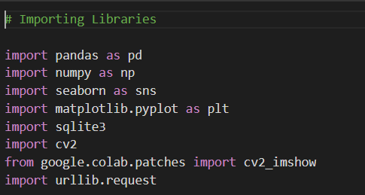
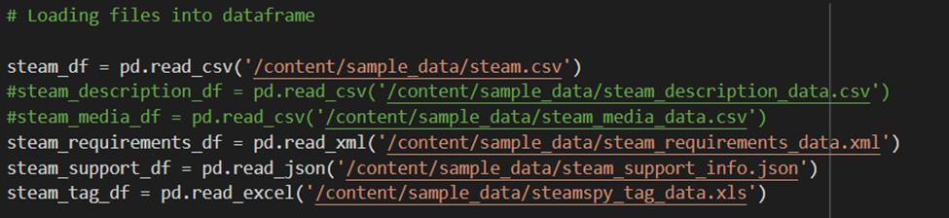
Essential key steps to demonstrated in our Python Notebook -Loading data into Data Frames. Integration of SQL and Python
File type used are:
.csv
.xml
.jason
.xls

Slide 5
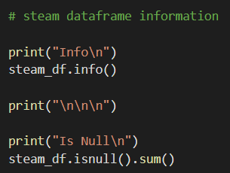
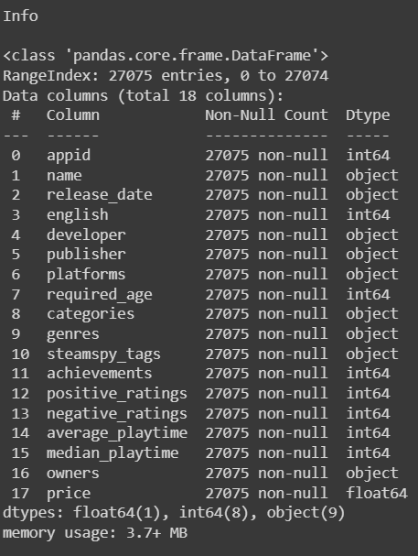
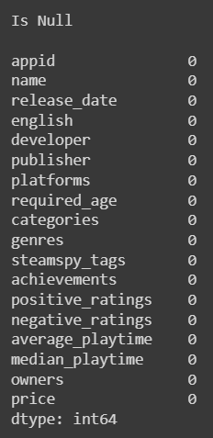
Drop any NULL, missing values or unwanted columns.
Using the isnull() and sum() methods, this code determines the number of null values (missing values) for each column in the steam_df DataFrame.

Slide 6
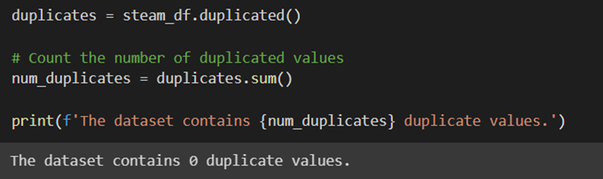
Drop duplicate values.
Using the duplicated() method from pandas, this code examines the steam_df Data Frame for duplicate rows.

Slide 7
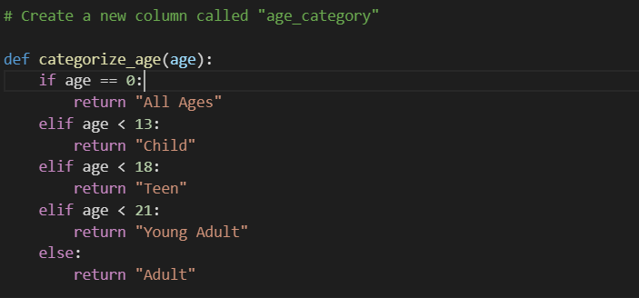
Adding a new column ‘age_category’

Slide 8
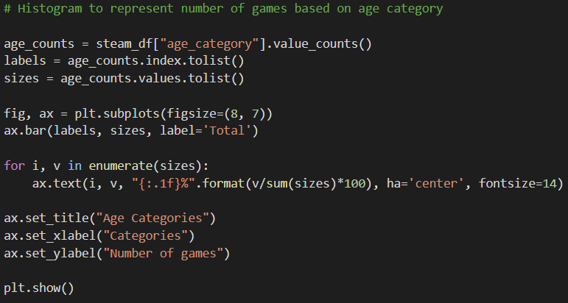
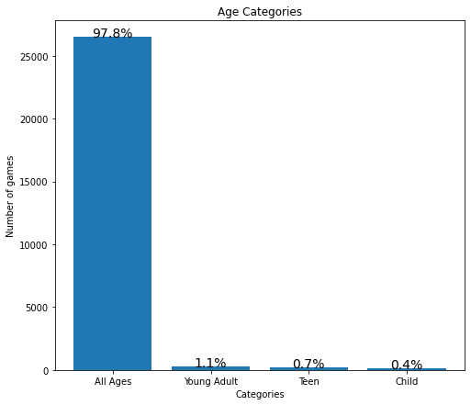
Check for outliers using a histogram.
This code snippet generates a horizontal bar chart to represent the number of games based on age category.

Slide 9
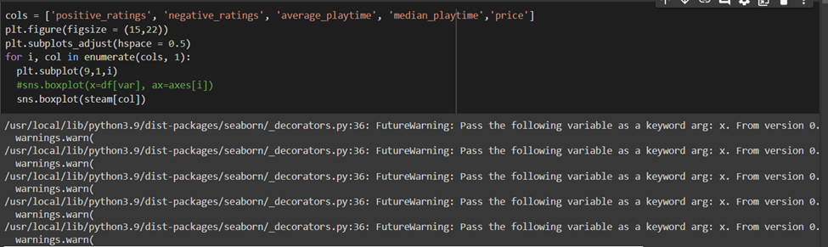
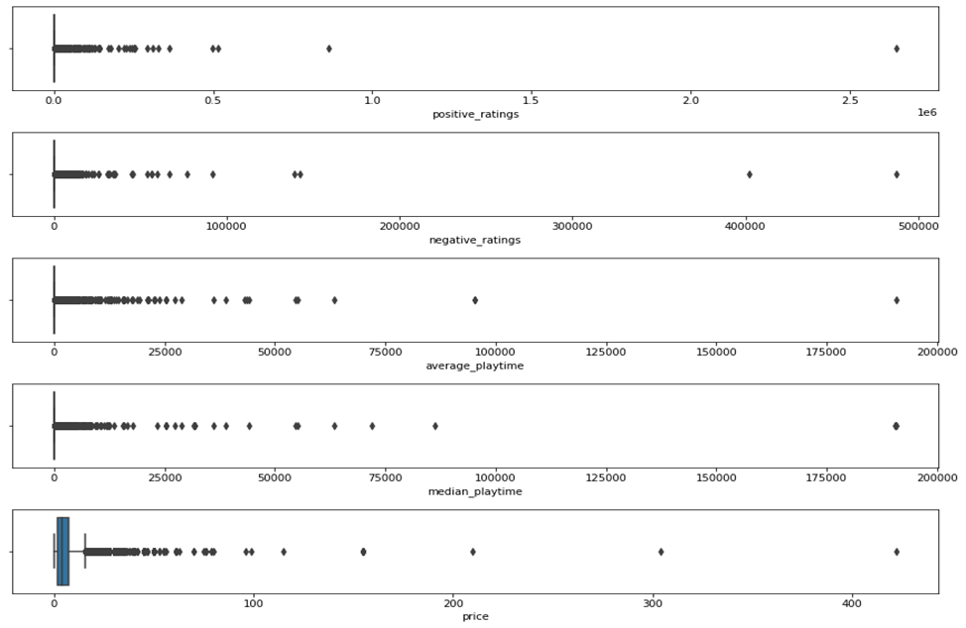
Check for outliers using a box plot.
This code creates a box plot for each of the columns specified in the cols list using the boxplot() function from the seaborn library, which is imported as sns.

Slide 10
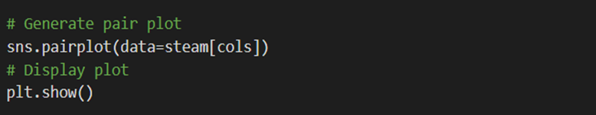
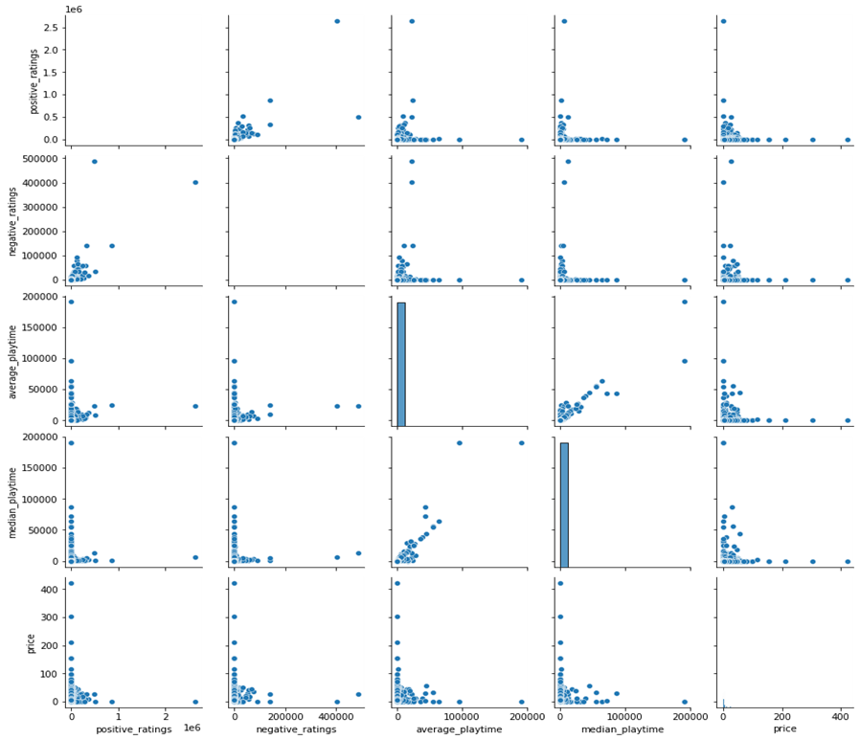
Plot features against each other using a pair plot.
Using the pairplot() function, this code creates a pairwise scatter plot matrix for the columns listed in the cols list. The subset of columns to be included in the plot is specified by the data parameter, which is set to steam[cols].
Columns used:
'positive_ratings', 'negative_ratings', 'average_playtime', 'median_playtime', 'price'

Slide 11
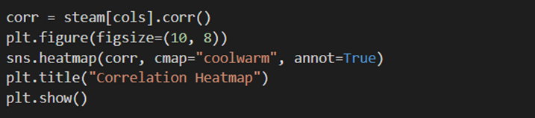
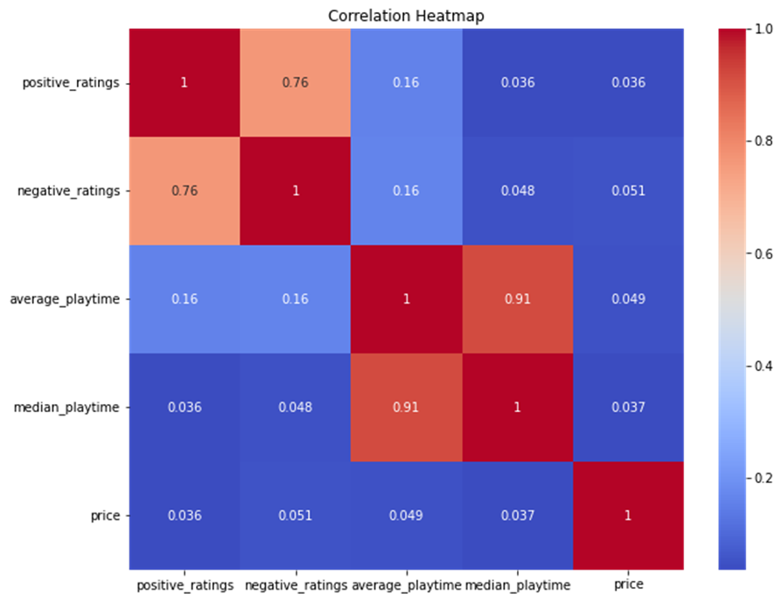
Use a Heatmap for finding the correlation between the features (Feature to Feature).
Using the corr() method from pandas, this code generates the correlation matrix for the columns given in the cols list. The heatmap() function from the seaborn library, is then used to show the resulting correlation matrix as a heatmap.
Columns used:
'positive_ratings','negative_ratings', 'average_playtime', 'median_playtime', 'price'

Slide 12
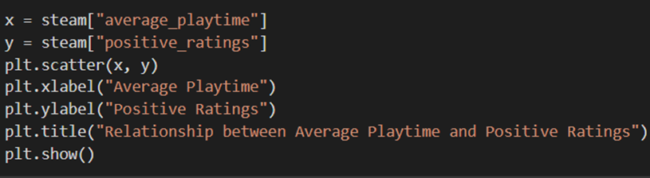
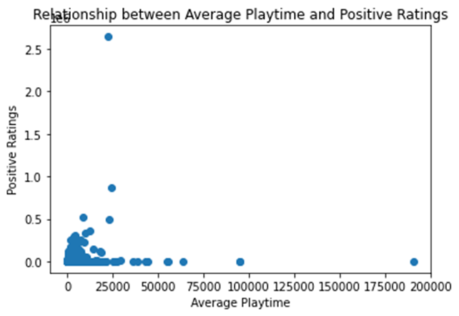
Use a scatter plot to show the relationship between 2 variables.
This code provides a way to visualize the relationship between two variables in the dataset and can be useful for identifying potential patterns or trends between the average_playtime and the positive_ratings column of the steam_df dataframe.

Slide 13
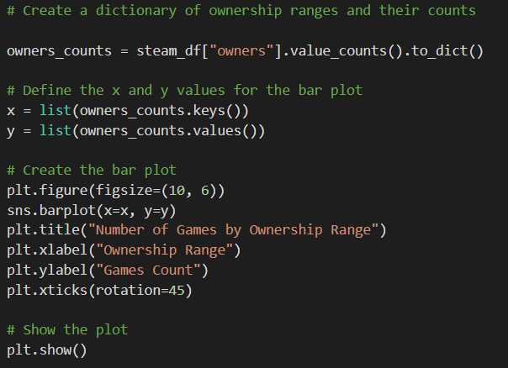
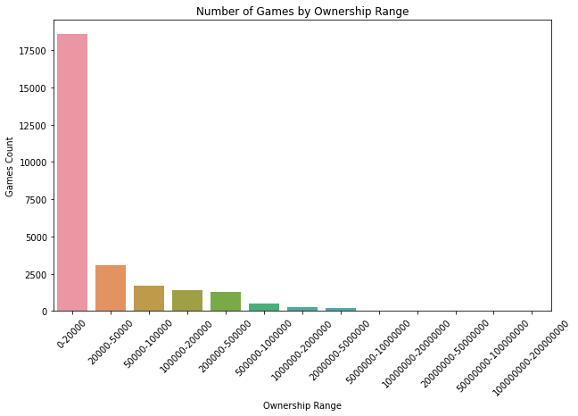
Creating Barplot to represent corresponding relationship
This bar plot is used to represent number of games according to its ownership range

Slide 14
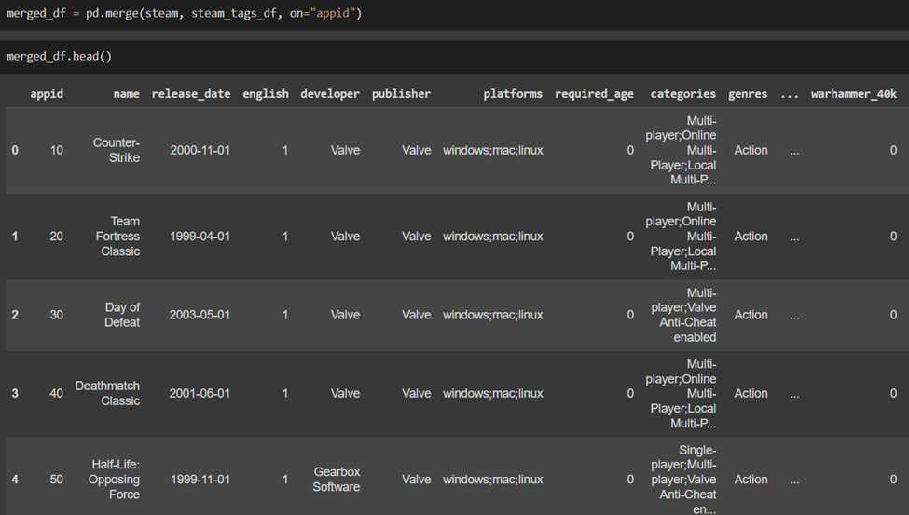
Merging two Data Frames.
Using pandas, we have merged two dataframes ‘steam_df’ and ‘steam_tag_df’ based on the ‘appid’ column.

Slide 15
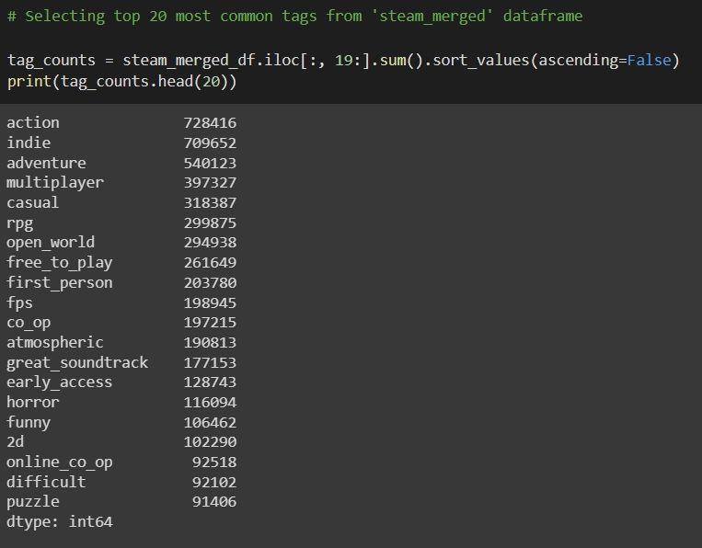
Slicing Data of a particular column value
This code selects top 20 most used tags from steam_merged dataframe and also shows the number of times it is used.
Moreover, .iloc[:, 19:] indexing syntax is used to select all the columns from 19th till the end.

Slide 16
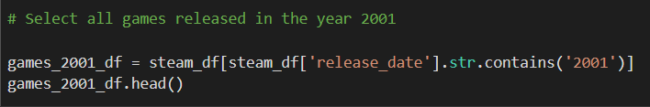
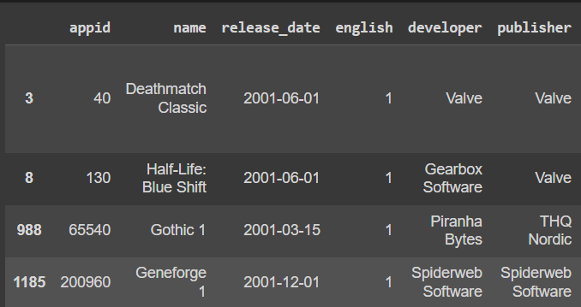
Slicing Data of a particular column value
This code selects all the games released in 2001 from ‘steam_df’ dataframe and shows the first five rows of the resulted dataframe.

Slide 17
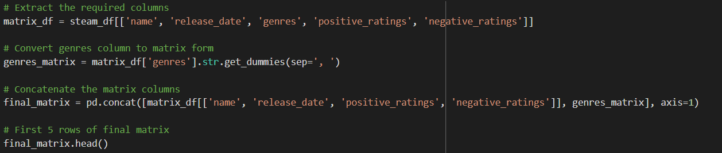
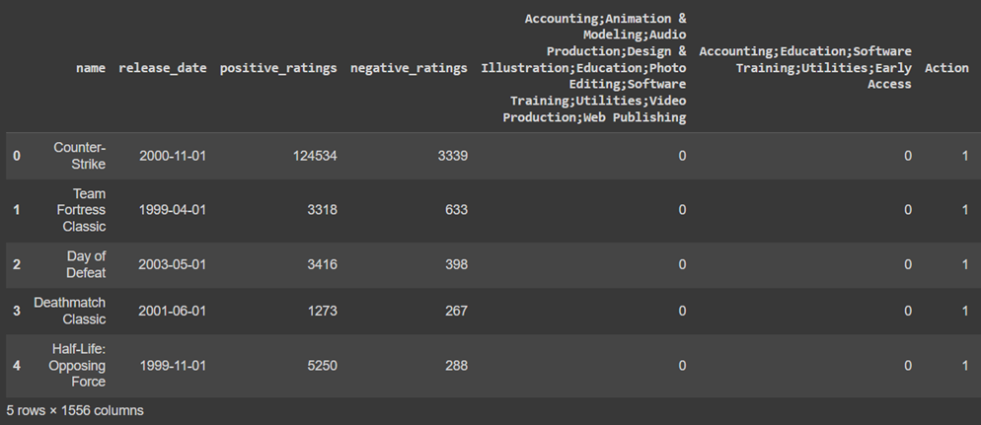
Representing data in matrix form.
This code extracts name, release date, genres, positive_rating, negative_rating and the converts the genres column into the matrix format which is concatenated with other column to create the final resulted matrix.

Slide 18
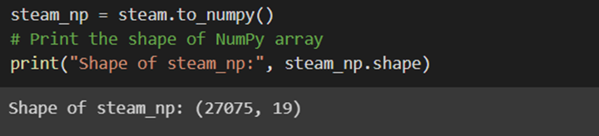
Upload data to Numerical Python (NumPy)
The .to NumPy () method is used in this code to convert the steam Data Frame to a NumPy array, which results in a new array with the same data as the original Data Frame. The original Data Frame’s rows and columns are all present in the resulting steam np array.

Slide 19
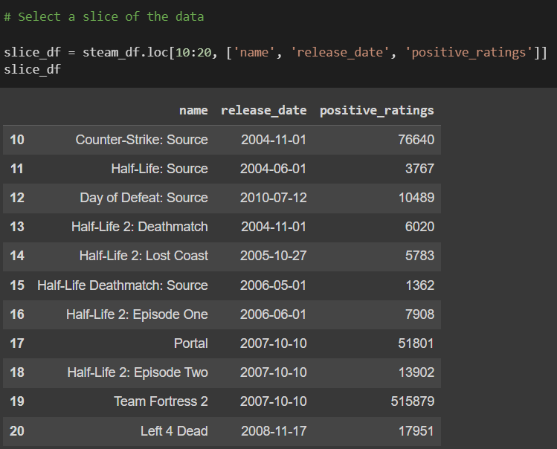
Select a slice or part of the data and display.
The names of the three columns ['name', 'release date', 'positive ratings'] are used and the resulting slice_df Data Frame contains only the specified rows and columns.

Slide 20
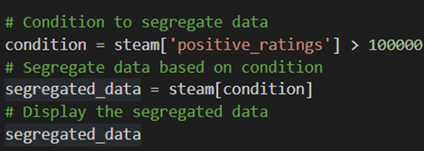
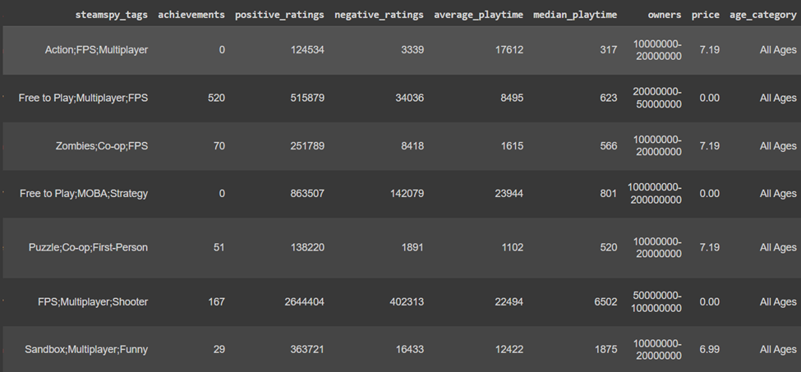
Use conditions and segregate the data based on the condition
In this case the positive ratings column must contain a value larger than 100000 for the condition to apply. Games with lower positive ratings are successfully filtered out since only rows with a positive ratings column value larger than 100000 are included in the segregated data Frame.

Slide 21
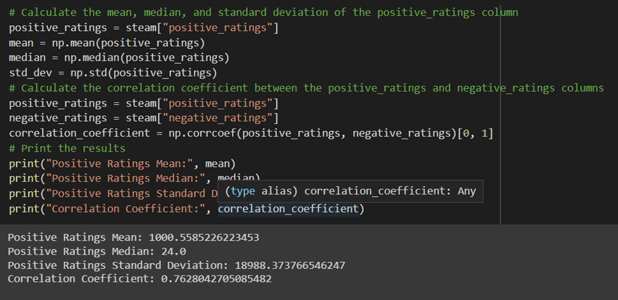
Use mathematical and statistical functions using libraries.
This code calculates some descriptive statistics for the positive_ratings column and the correlation coefficient between the positive_ratings and negative_ratings columns in the steam DataFrame.

Slide 22
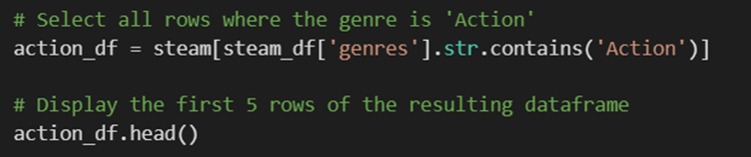
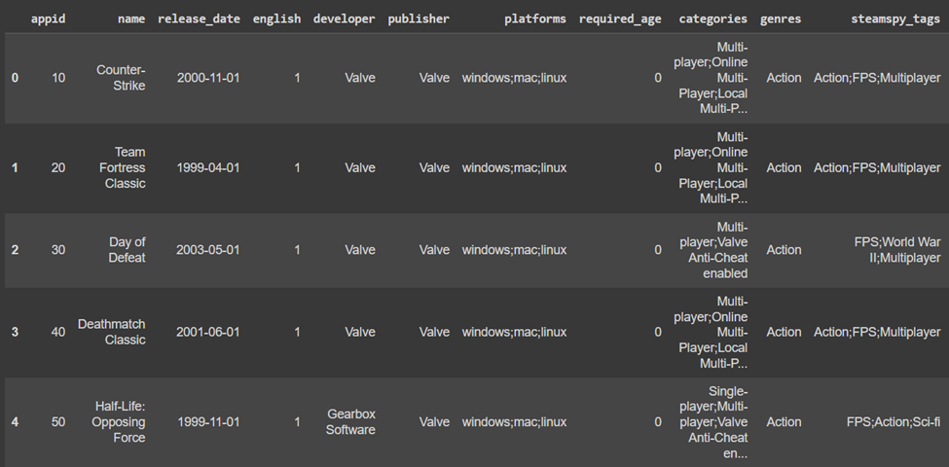
Select data based on a category (categorical data based).
With this code, a new dataframe called action_df will be created that contains all rows that have the word "Action" in the genres column. Only games that fall under the "Action" genre will be included in the final dataframe.

Slide 23
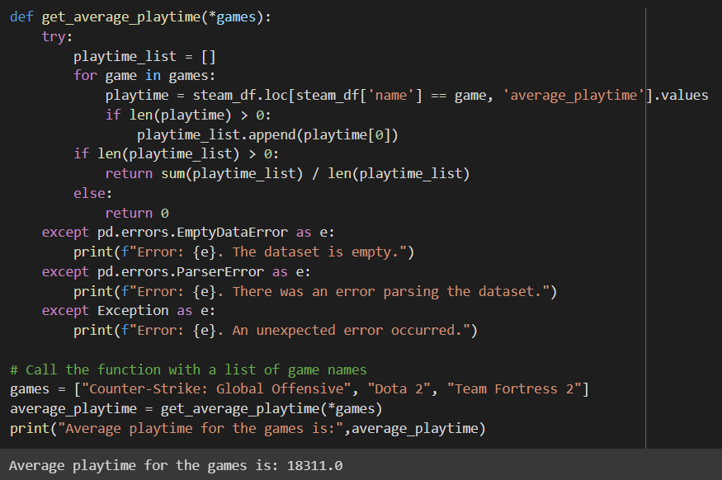
Write your own functions using *args and handle exceptions in the functions.
This function is used to calculate the average playtime of the games that are passed in the parameters.
Moreover, this functions also handles all types of exceptions such as empty dataset and parsing error

Slide 24
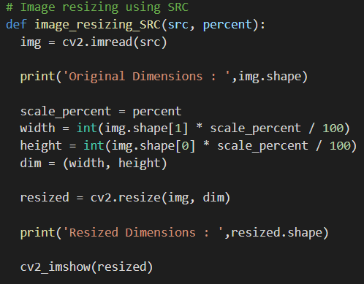
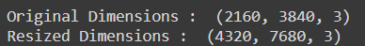

Image Resizing using SRC
Output

Slide 25
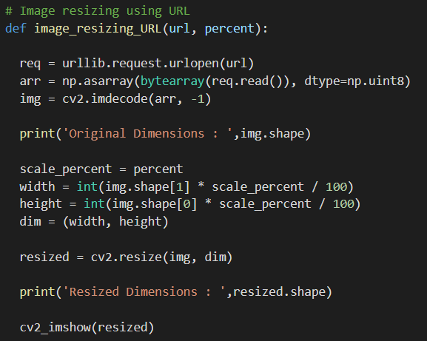
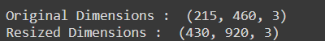

Image Resizing using URL
Output

Slide 26
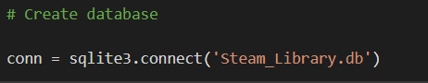
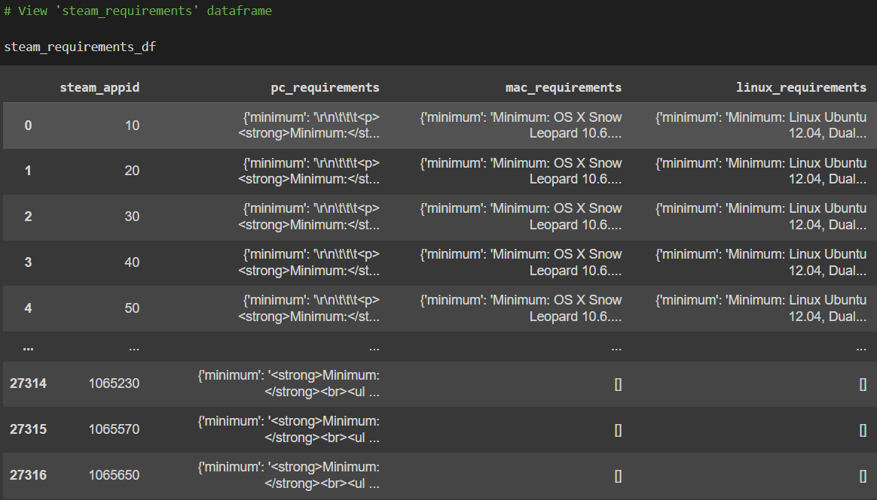
SQL Integration
Created steam_library database using sql lite3
As we can see steam_requirements dataframe has null values in the form of ‘[]’ in mac_requiremnets and linux_requirements columns.

Slide 27
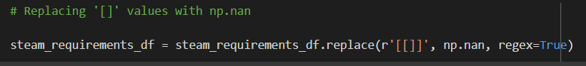
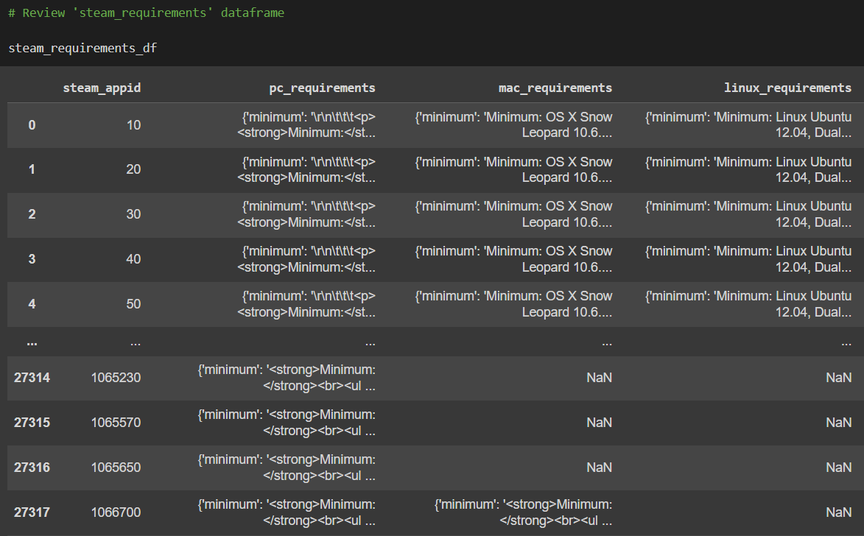
Replacing ‘[]’ with np.nan
Using this code we have replaced ’[]’ with np.nan, which is used to represent ‘not available’ values in the data.

Slide 28
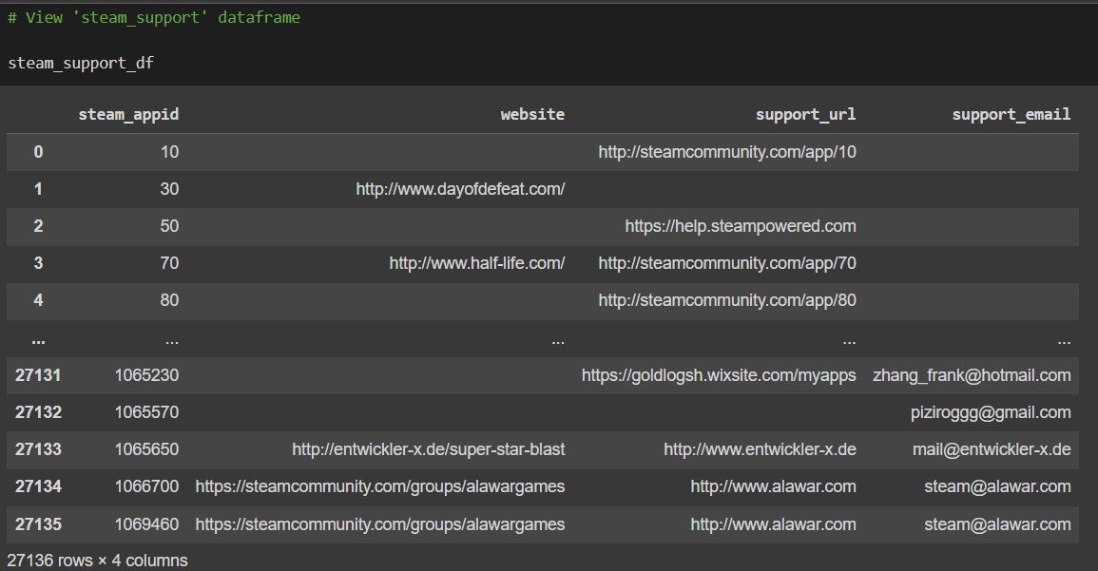
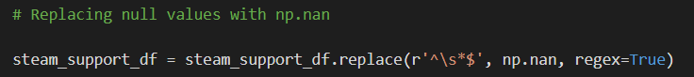
Replacing ‘Blank values’ with np.nan
Using this code we have filled Blank values with np.nan

Slide 29
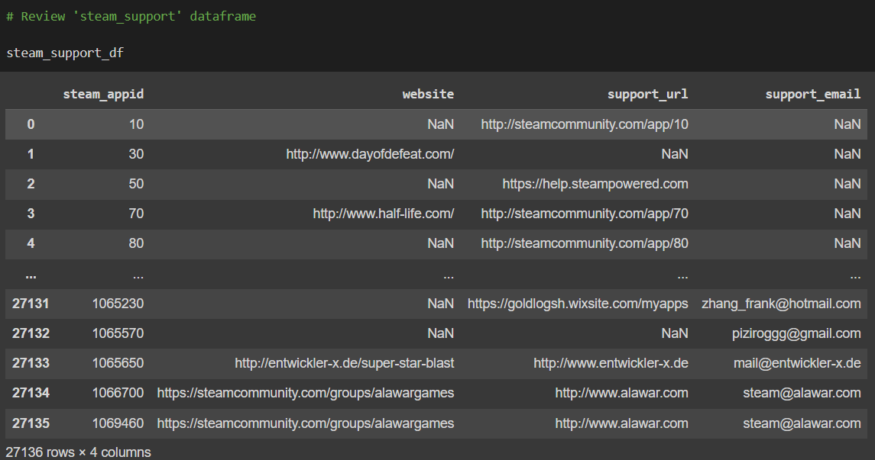
Resulted Output

Slide 30
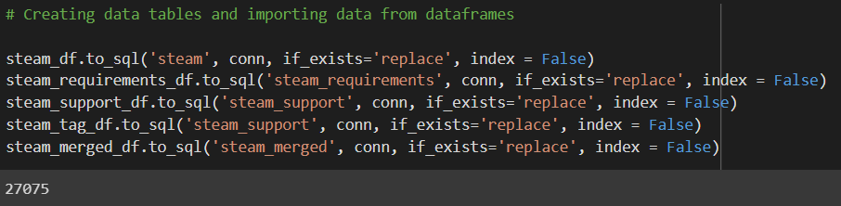
Importing data into Sql tables from dataframe

Slide 31
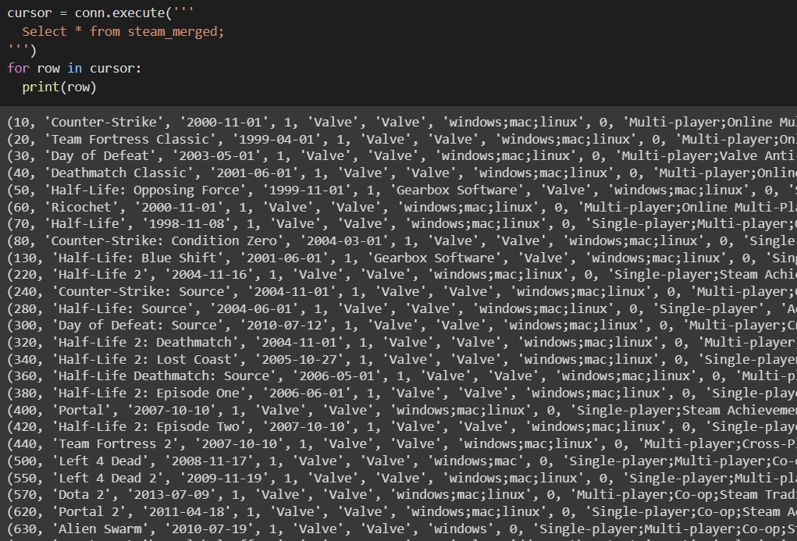
Resulted SQL table

Slide 32
Conclusion
We successfully investigated the distribution of games according to age limits and looked at the relationships between other factors like price, ratings, and its other categories in order to anticipate the drift about the various types of games.
Overall, a Python and SQL project employing the Steam dataset might offer insightful analysis of user behavior and the gaming business, which could be useful for game designers and marketers.

Slide 33
Thank You

